Slide 1


Slide 2
University of Engineering and Technology Peshawar (Jalozai Campus) Department of Electrical Engineering
FYP TITLE: PEA PLANT QUALITY ASSESSMENT USING DEEP LEARNING TECHNIQUES (CNN VGG16)
GROUP MEMBER’S Abdullah Zunorain (19jzele0338)
Akif Fazal (19jzele0322)
Naveed Khan (19jzele0350)
SUPERVISOR
Dr. Irfan Ahmed
SESSION: (2019-2023)

Slide 3
INTRODUCTION
Role of Deep Learning Techniques:
Deep learning techniques, such as Convolutional Neural Networks (CNNs), have revolutionized image analysis and pattern recognition.
By harnessing the power of deep learning, we can develop automated systems for disease detection with high accuracy and efficiency.
Our project utilizes the CNN VGG16 architecture, known for its exceptional performance in computer vision tasks.

Slide 4
INTRODUCTION
Importance of Pea Plants:
Pea plants are a significant crop globally, contributing to food security and sustainable agriculture.
However, they are prone to various diseases that can negatively impact yield and crop quality.
Timely and accurate disease detection is crucial for effective management and improved pea plant health.

Slide 5
PROBLEM STATEMENT AND MOTIVATION
Problem Statement:
Pea plant diseases pose a significant challenge in the agricultural industry, leading to reduced crop yield and quality.
Timely and accurate detection of these diseases is essential for effective disease management and minimizing economic losses.
However, manual inspection and identification of diseases in pea plants can be time-consuming, subjective, and prone to errors.

Slide 6
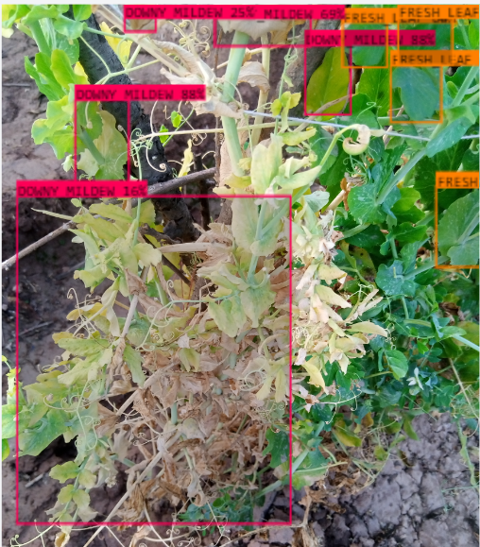
PROBLEM STATEMENT AND MOTIVATION
2. Motivation:
The motivation behind our project is to address the limitations of traditional disease detection methods and provide a more efficient and reliable solution.
By leveraging advanced technologies such as deep learning and machine learning algorithms, we aim to develop an automated system for pea plant disease detection.
This automated system will offer several advantages, including increased accuracy, faster processing time, and the ability to handle large-scale data.

Slide 7
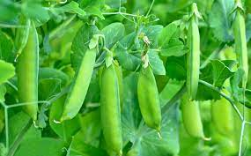

OBJECTIVES
Our project aims to develop an automated system for pea plant quality assessment and disease detection.
By leveraging deep learning techniques, we seek to provide farmers and agronomists with a reliable tool for early disease identification and improved crop management.
The project aims to enhance disease management strategies, optimize resource allocation, and ensure sustainable pea plant cultivation.

Slide 8
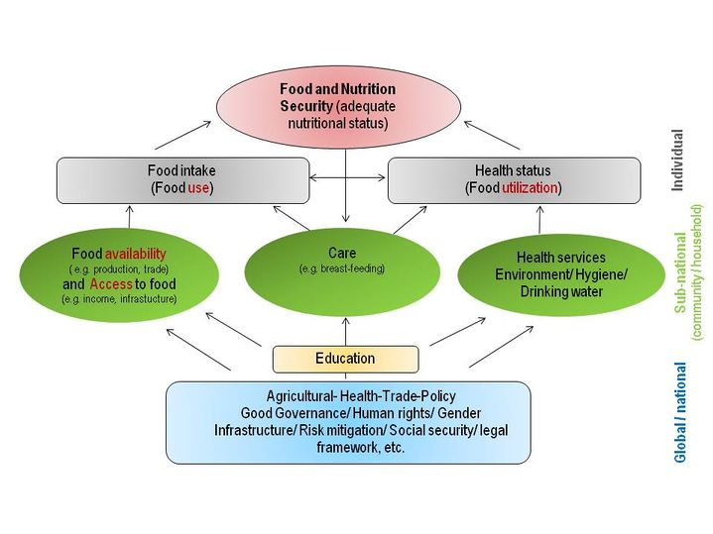
POTENTIAL IMPACT AND BENEFITS
Successful implementation of our project can significantly impact the agricultural industry.
Accurate disease detection can enable early intervention, minimizing yield losses, and reducing reliance on chemical treatments.
Enhanced crop management through our automated system can improve overall crop health, productivity, and ultimately contribute to global food security.

Slide 9
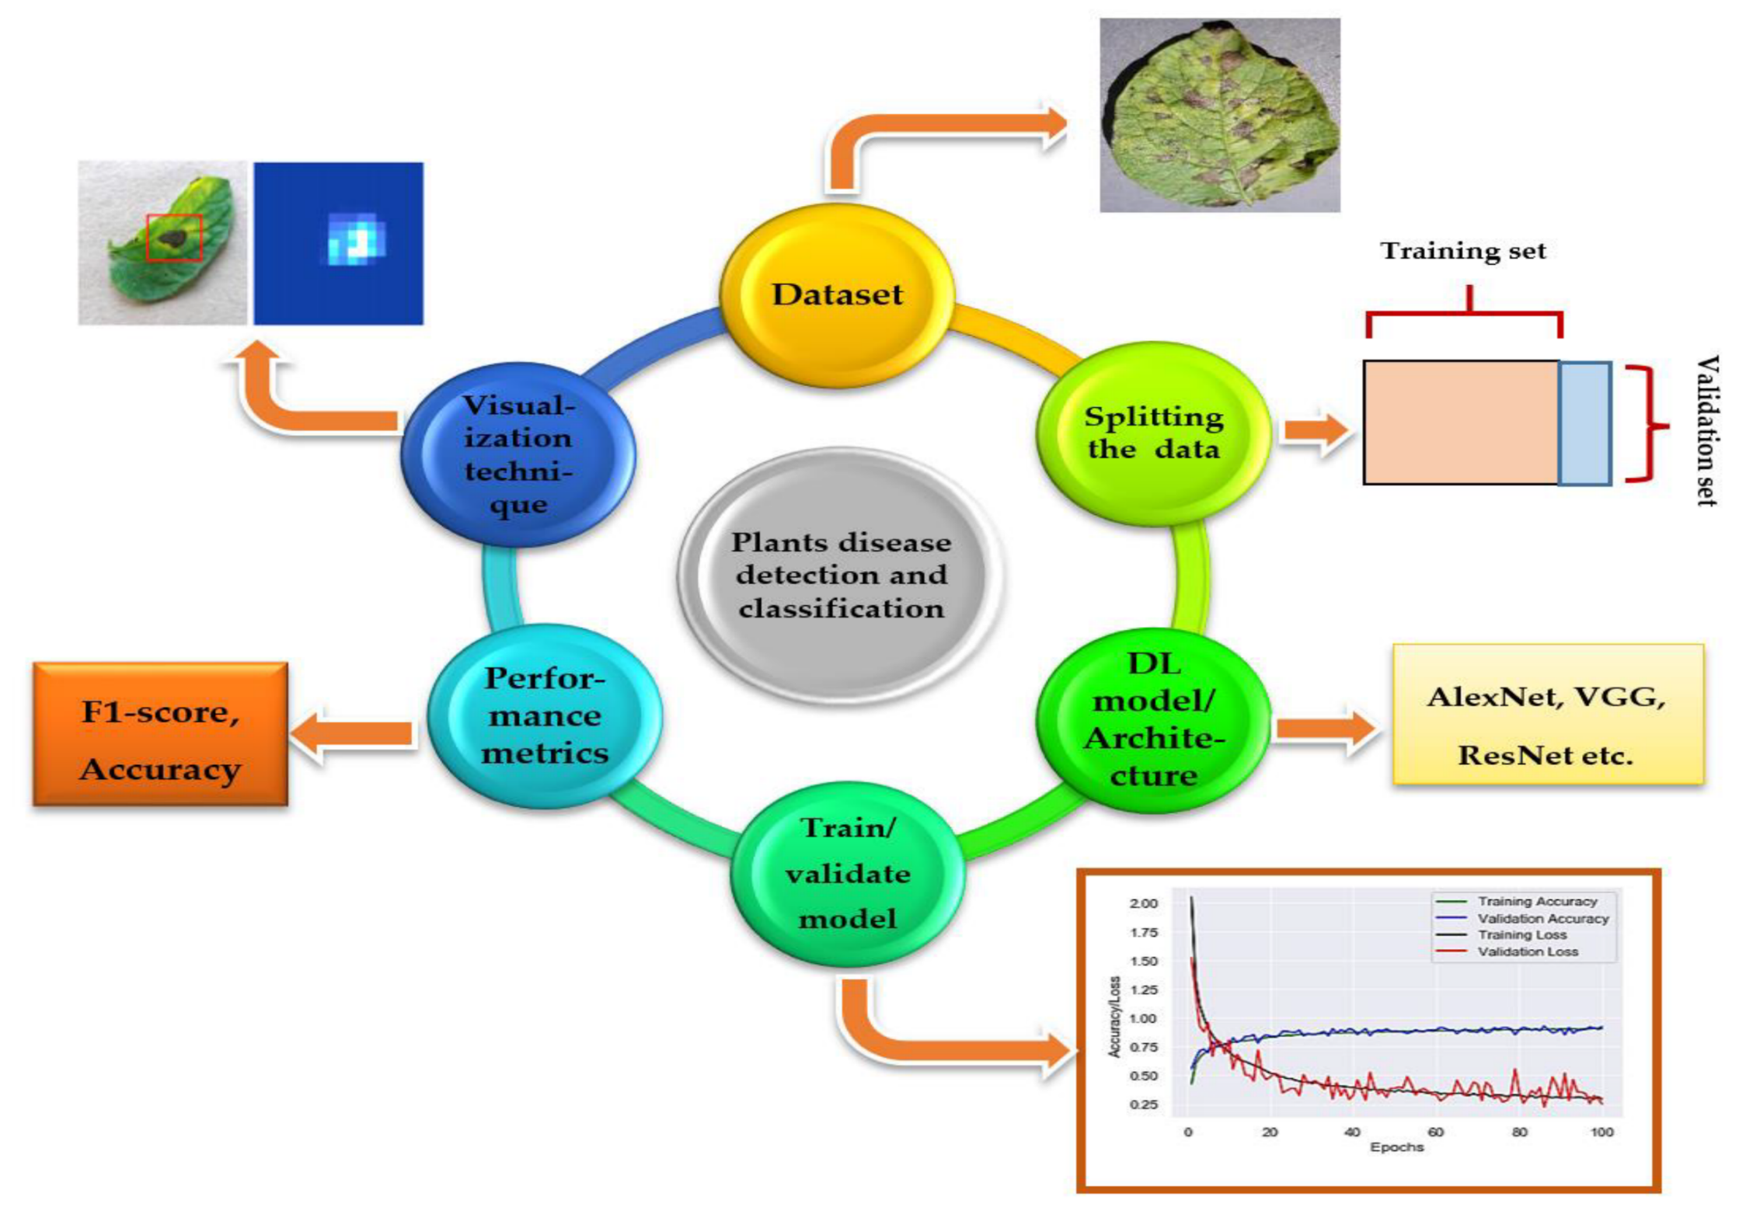
METHODOLOGY
First, the dataset is collected then split into three parts, normally into 80% of training,10% of validation set & 10% of testing.
After that, DL models are trained from scratch or by using transfer learning technique, and their training /validation/ testing plots are obtained to indicate the significance of the models.
Then, performance metrics are used for the classification of images (type of particular plant disease), and finally, visualization techniques/mappings are used to detect/ localize/ classify the images.

Slide 10
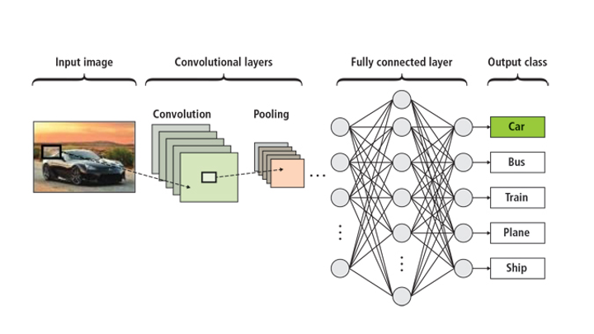
MODEL IMPLEMENTATION
Select the appropriate machine learning models, such as VGG16, Sequential Custom CNN, Naive Bayes, Random Forest, or YOLOV8, for plant disease detection.
Implement and train the chosen models using the prepared dataset, optimizing their respective parameters. Evaluate the performance of each model using metrics like accuracy, precision, recall, and F1 score to compare their effectiveness in classifying plant diseases.
Source: https://dugujonathangrant.blogspot.com/2022/07/3d-convolutional-neural-network.html

Slide 11
TESTING AND EVALUATION
Evaluate the trained models using a separate testing dataset, calculating metrics like accuracy, precision, recall, and F1 score to assess their performance in plant disease classification.
Compare the results of the models based on the evaluation metrics to determine their effectiveness and identify the top-performing model for accurate and reliable plant disease identification.

Slide 12
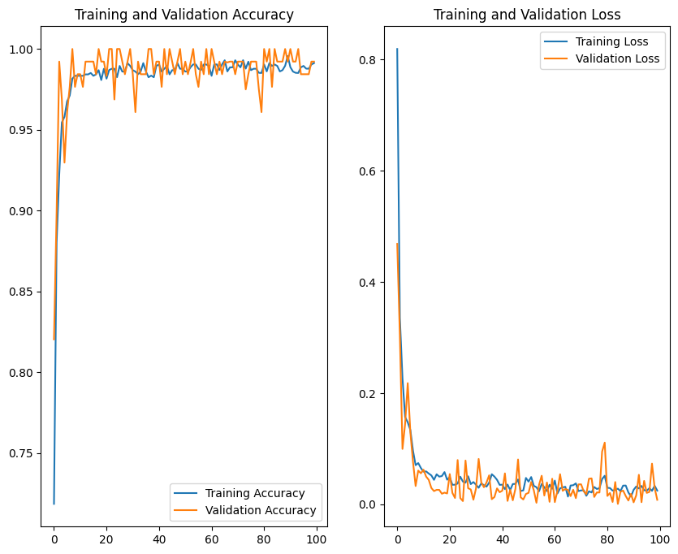
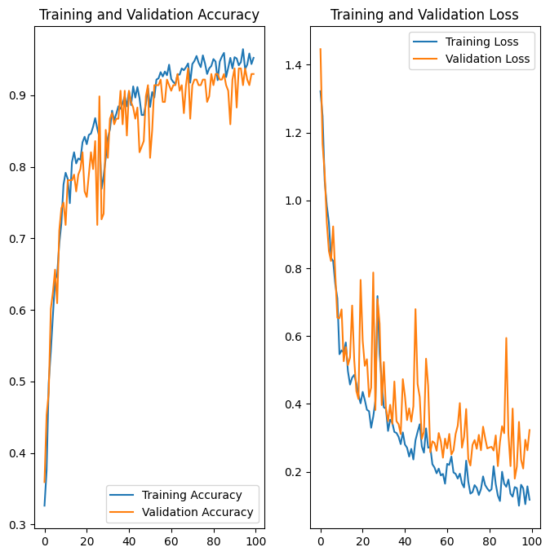
TESTING RESULTS
VGG16
CUSTOM CNN

Slide 13
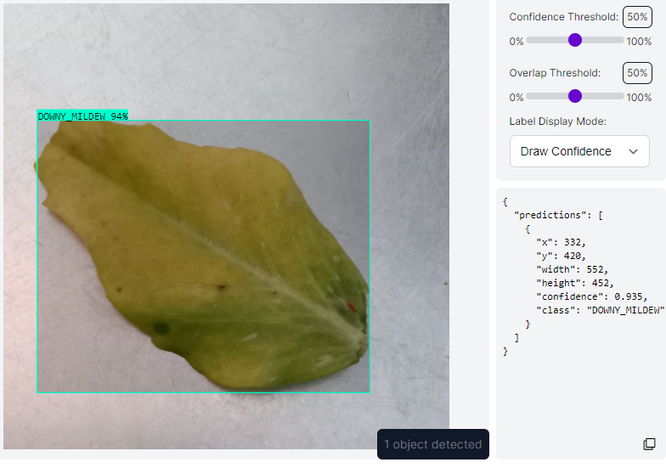
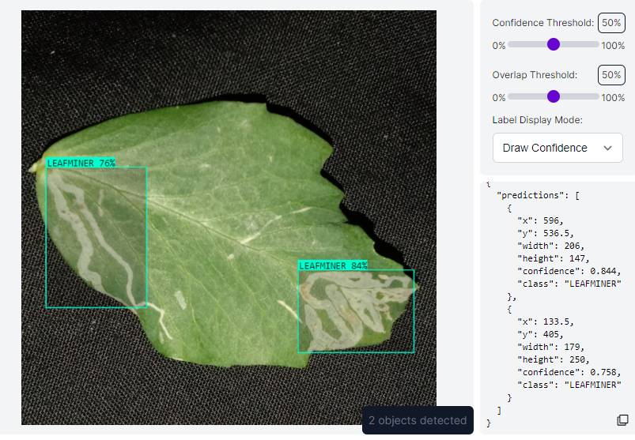
MODEL DEPLOYMENT

Slide 14
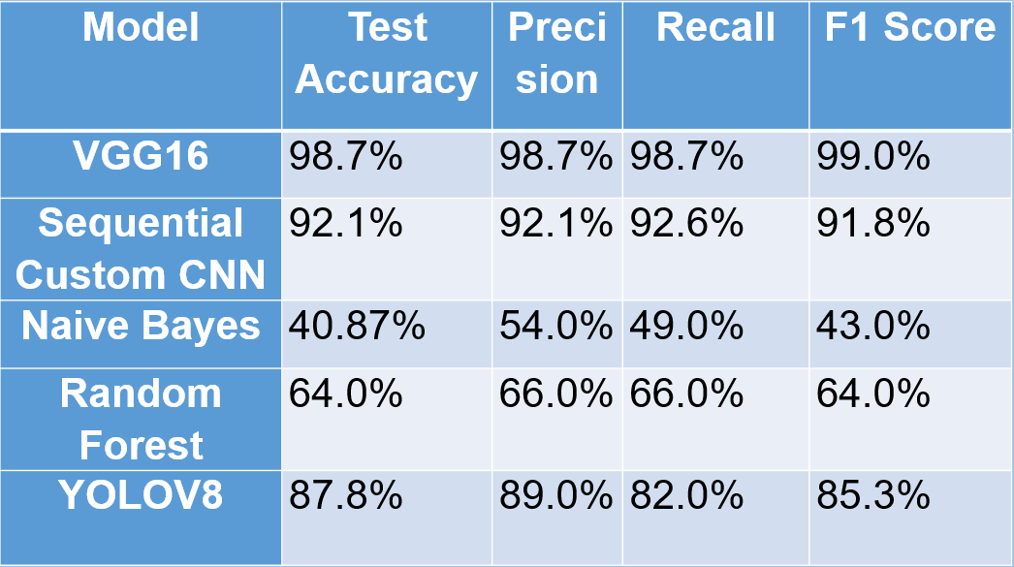
CONCLUSION
VGG16 demonstrated the highest performance across all evaluation metrics, including accuracy, precision, recall, and F1 score.
The Sequential Custom CNN showed promise but fell slightly short of VGG16's performance, indicating the potential of custom-designed models for plant disease classification.
Naive Bayes and Random Forest exhibited lower performance, highlighting the limitations of simplistic models in image-based classification tasks.

Slide 15
LIMITATIONS AND FUTURE WORK:
Limitations:
Limited availability of diverse and representative pea plant datasets.
Dependency on high computational resources for training deep learning models.
Potential challenges in generalizing the model to different environmental conditions and disease variations.
Future Work:
Explore transfer learning techniques to leverage pre-trained models and address data scarcity.
Investigate ensemble methods to combine the strengths of multiple models for improved disease detection.
Conduct field trials to validate the performance of the developed system in real-world pea plant cultivation settings.

Slide 16
Question and Answer Session

